Slide 1
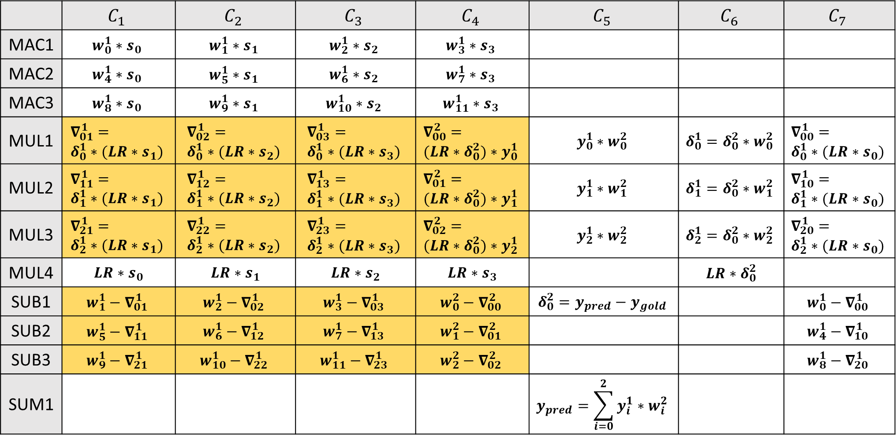



ANN Pipeline Stage
Current Iteration
ReLU
ReLU’
Next Iteration
 | $$C_{1}$$ | $$C_{2}$$ | $$C_{3}$$ | $$C_{4}$$ | $$C_{5}$$ | $$C_{6}$$ | $$C_{7}$$
MAC1 | $$w_{0}^{1}∗s_{0}$$ | $$w_{1}^{1}∗s_{1}$$ | $$w_{2}^{1}∗s_{2}$$ | $$w_{3}^{1}∗s_{3}$$
MAC2 | $$w_{4}^{1}∗s_{0}$$ | $$w_{5}^{1}∗s_{1}$$ | $$w_{6}^{1}∗s_{2}$$ | $$w_{7}^{1}∗s_{3}$$
MAC3 | $$w_{8}^{1}∗s_{0}$$ | $$w_{9}^{1}∗s_{1}$$ | $$w_{10}^{1}∗s_{2}$$ | $$w_{11}^{1}∗s_{3}$$
MUL1 | $$∇_{01}^{1}= \\ δ_{0}^{1}∗(LR∗s_{1})$$ | $$∇_{02}^{1}= \\ δ_{0}^{1}∗(LR∗s_{2})$$ | $$∇_{03}^{1}= \\ δ_{0}^{1}∗(LR∗s_{3})$$ | $$∇_{00}^{2}= \\ (LR∗δ_{0}^{2})∗y_{0}^{1}$$ | $$y_{0}^{1}∗w_{0}^{2}$$ | $$δ_{0}^{1}=δ_{0}^{2}∗w_{0}^{2}$$ | $$∇_{00}^{1}= \\ δ_{0}^{1}∗(LR∗s_{0})$$
MUL2 | $$∇_{11}^{1}= \\ δ_{1}^{1}∗(LR∗s_{1})$$ | $$∇_{12}^{1}= \\ δ_{1}^{1}∗(LR∗s_{2})$$ | $$∇_{13}^{1}= \\ δ_{1}^{1}∗(LR∗s_{3})$$ | $$∇_{01}^{2}= \\ (LR∗δ_{0}^{2})∗y_{1}^{1}$$ | $$y_{1}^{1}∗w_{1}^{2}$$ | $$δ_{1}^{1}=δ_{0}^{2}∗w_{1}^{2}$$ | $$∇_{10}^{1}= \\ δ_{1}^{1}∗(LR∗s_{0})$$
MUL3 | $$∇_{21}^{1}= \\ δ_{2}^{1}∗(LR∗s_{1})$$ | $$∇_{22}^{1}= \\ δ_{2}^{1}∗(LR∗s_{2})$$ | $$∇_{23}^{1}= \\ δ_{2}^{1}∗(LR∗s_{3})$$ | $$∇_{02}^{2}= \\ (LR∗δ_{0}^{2})∗y_{2}^{1}$$ | $$y_{2}^{1}∗w_{2}^{2}$$ | $$δ_{2}^{1}=δ_{0}^{2}∗w_{2}^{2}$$ | $$∇_{20}^{1}= \\ δ_{2}^{1}∗(LR∗s_{0})$$
MUL4 | $LR∗s_{0}$ | $LR∗s_{1}$ | $LR∗s_{2}$ | $LR∗s_{3}$ |  | $LR∗δ_{0}^{2}$
SUB1 | $$w_{1}^{1}−∇_{01}^{1}$$ | $$w_{2}^{1}−∇_{02}^{1}$$ | $$w_{3}^{1}−∇_{03}^{1}$$ | $$w_{0}^{2}−∇_{00}^{2}$$ | $${δ_{0}^{2}=y}_{pred}−y_{gold}$$ |  | $$w_{0}^{1}−∇_{00}^{1}$$
SUB2 | $$w_{5}^{1}−∇_{11}^{1}$$ | $$w_{6}^{1}−∇_{12}^{1}$$ | $$w_{7}^{1}−∇_{13}^{1}$$ | $$w_{1}^{2}−∇_{01}^{2}$$ |  |  | $$w_{4}^{1}−∇_{10}^{1}$$
SUB3 | $$w_{9}^{1}−∇_{21}^{1}$$ | $$w_{10}^{1}−∇_{22}^{1}$$ | $$w_{11}^{1}−∇_{23}^{1}$$ | $$w_{2}^{2}−∇_{02}^{2}$$ |  |  | $$w_{8}^{1}−∇_{20}^{1}$$
SUM1 |  |  |  |  | $$y_{pred}=\sum_{i=0}^{2}{y_{i}^{1}∗w_{i}^{2}}$$
$$∇_{ij}^{1}=δ_{i}^{1}∗LR∗s_{j}$$
$$∇_{ij}^{2}=LR∗δ_{i}^{2}∗y_{j}^{1}$$
$$y_{i}^{1}=\left(h_{i}^{1}>0\right) ? h_{i}^{1} :0$$
$$δ_{i}^{1}=\left(h_{i}^{1}>0\right) ?\left(w_{i}^{2}∗δ_{i}^{2}\right) :0, where i∈\{0,1,2\}$$

